Slide 1
Dimensionality & Dimensions of Hyperion Planning

Slide 2
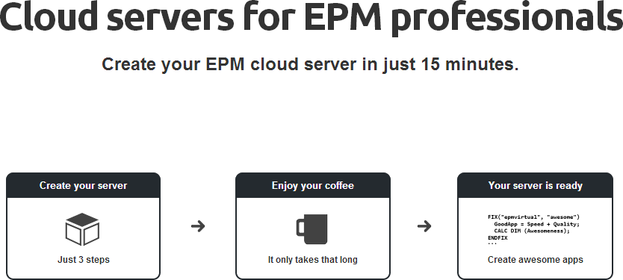

Slide 3
This tutorial will take you through the dimensionality concepts of Hyperion Planning.
Dimensions are the basic foundation of the Hyperion Planning application and are composed of members and the place holders of the stored members in the outline.
Application dimensions together referred as an outline and it means the structure of an Hyperion planning application or cube.
Hyperion Planning application has a set of standard dimensions and custom dimensions. The standard dimensions are the mandatory dimensions of any planning application.
The Standard dimensions vary between the multi and single currency applications.

Slide 4
The list of standard dimensions for the single and multi currency application are as follows:
The Standard dimensions are the mandatory dimensions for the planning application and a Hyperion Planning application can have additional custom dimensions. Although the limit on number of dimensions in an application is 20, the rule of thum is; lesser the dimensions, better the performance of an application.
Single Currency
Account
Period
Year
Scenario
Version
Entity
Multi Currency
Account
Period
Year
Scenario
Version
Entity
HSP_Rates
Currency

Slide 5
Planning application stores data in Essbase cubes. Essbase is a multi-dimensional database which is structured using the concept of dimensions. Dimensions will classify the data values and data is accessed and stored in a cube intersection consisting of a member from each of the dimensions in an application.
Lets look at the dimensions and its properties more detail in the following sections.

Slide 6
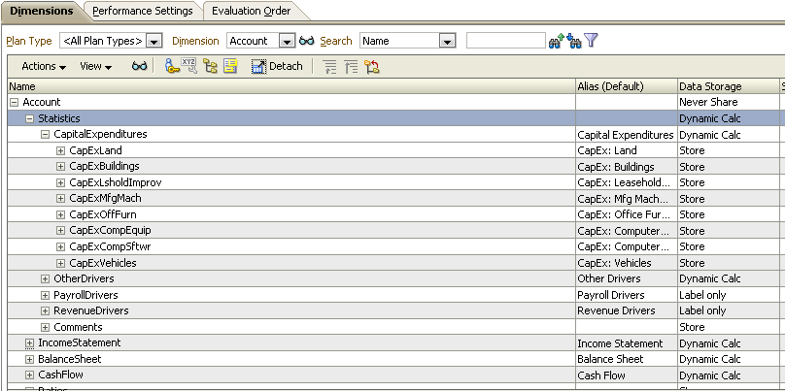
Account Dimension
Account dimension is one of the standard dimensions. The measures, metrics, and drivers of the application are part of the Account dimension.
Below figure shows the Account dimension view in a planning application:

Slide 7
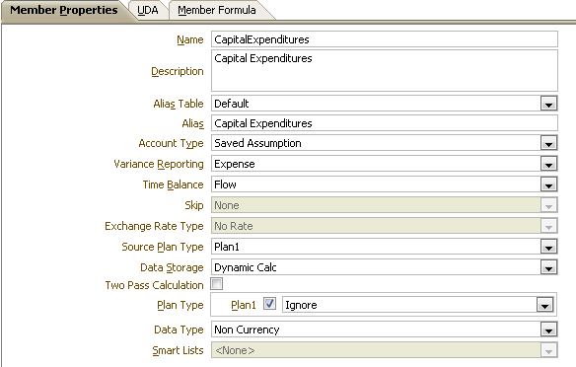
Account Dimension – Properties
In this section, we will go through about the member properties of the Account dimension. Select a member in the account dimension and click on view, it will lead to the below properties window,
Name: This is the name of the member
Description: This is an optional field where the description can be provided
Alias: It is an optional field where an alternate name(s) can be provided for the member

Slide 8
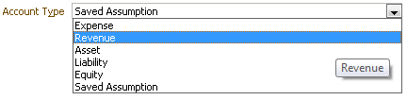
Account Type: The appropriate account type has to be selected for the member. The available account are as shown.
Variance reporting: This option will be selected based on the selected account type. Though we can edit the default options and change the setting. Apart from account type Expense all other accounts are default Non-expense

Slide 9
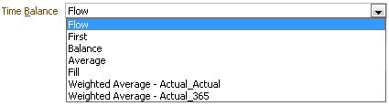
Time Balance: This property will determine the nature of aggregation. By default, it will be selected based on the account type.
Flow: This option will add Jan, Feb and Mar values to Quarter1
First: This option uses the beginning value of Jan to Quarter1
Balance: This option uses the ending value that is of March to Quarter1
Average: This option averages the data value of Jan, Feb and March
Weighted Average – Actual-Actual: This setting assumes that the year is leap year. The Q1 value will be calculated by first multiplying the monthly values with the no of days of the month and the sum all the values post multiplication and divide by the total number of days of the quarter
Weighted Average-Actual_365: This setting does not assume that the year is leap year. The Q1 values are calculated by first multiplying the monthly values with the number of days of the month and then summing all the values post multiplication and dividing by the total number of days in the quarter.

Slide 10
The below table describes how the data spreading depends on the time balance property,
Time Balance property | Jan | Feb | Mar | Quarter1
First | 20 | 30 | 40 | 20
Balance | 20 | 30 | 40 | 40
Flow | 20 | 30 | 40 | 90
Average | 20 | 30 | 40 | 30
Weighted Average_Average | 20 | 30 | 40 | 30
Weighted Average_Actual_Actual | 20 | 30 | 40 | 30

Slide 11
Skip: This property will handle the missing values and zero values.
Exchange Rate Type: This property is applicable to only multi-currency applications. It tells the account member that which table to look for exchange rates.
Data Storage: The following are the data storage options,
StoreData: This option will store the data in the database and consumes the disk space.
DynamicCalcAndStore: This setting does not store data until a user retrieves data for the first time.
Dynamic Calc: This setting never stores data and retrieves data every time a user requests. It is mostly used for account dimension members.
ShareData: This setting can be used for alternate hierarchies.
NeverShare: This setting can be used when a parent has single child to avoid implicit sharing.
LabelOnly: This setting is for navigational convenience. It does not have the ability to store data.

Slide 12
Two-Pass Calculation: This setting can be used for percentage or ratio calculation
Plan Type: It will display the application cube name
Aggregation Options: This setting tells how the data has to be aggregated to its parent
Data Type: The data type tells how to display the values

Slide 13
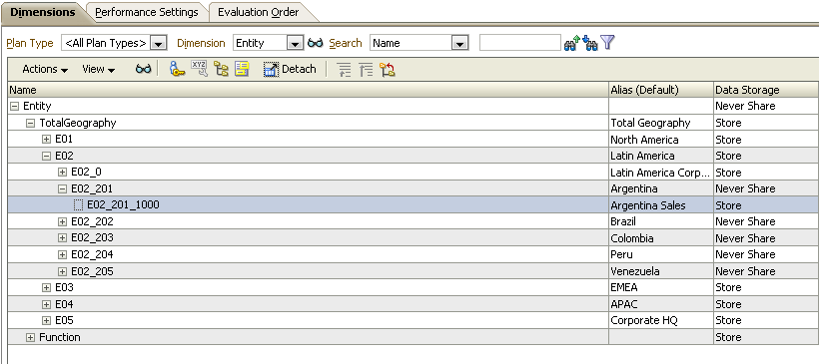
Entity Dimension
Entity dimension is one of the standard dimensions that defines business organization hierarchy. The dimension typically includes geographical regions, departments and business units in an organization.
Below figure shows the Entity dimension view in the planning application,

Slide 14
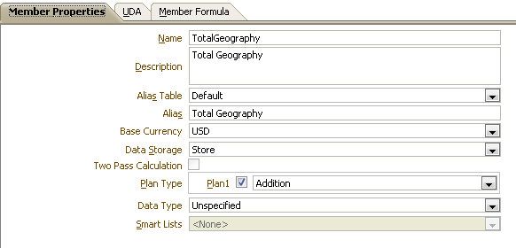
Entity Dimension – Properties
In this section, we will go through about the member properties of the Account dimension. Select a member in the account dimension and click on view, it will lead to the below properties window (refer to the account dimension section for repeating properties),
Two pass calculation: This setting can be used for percentage or ratio calculation
Base Currency: This setting is applicable only to the Multi-currency application. Provide the currency for that entity

Slide 15
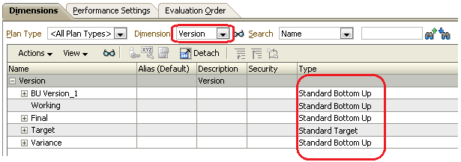
Version Dimension
Version Dimension is used to enable the versioning functionality for the Planning applications. Two types of members can be created in the version dimension,
Standard bottom up
Standard Target
One can enter data only at level zero or base level members in Standard Bottom Up. Whereas in standard target, data entry is possible at any level of the hierarchy.
Below figure shows the version dimension view in the planning application,

Slide 16
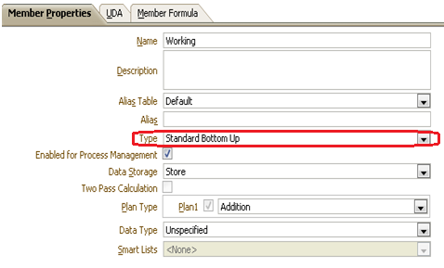
Version Dimension – Properties
In this section, we will go through about the member properties of the version dimension. Select a member in the version dimension and click on view, it will lead to the below properties window,
Type: This setting decides the type of the version
Enable process management: This setting will tell which version member to participate in the workflow processes.
Note: Version member, whose type is standard target cannot be enabled for workflow.

Slide 17
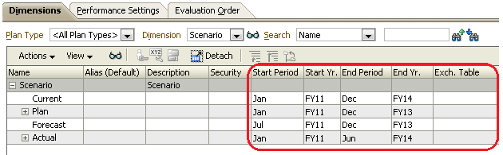
Scenario Dimension
Scenario dimension helps broad categorization of data in the planning application. Entity dimension is always associated with the scenario and version dimension.
Below figure shows the Scenario dimension view in the planning application,
Plan, Actual, and Forecast are the most common Scenario members as we need a 'Plan' scenario member to enter planned or budget numbers, and the 'actual' member is need to enter actual data.

Slide 18
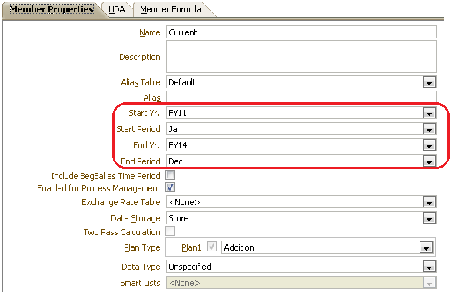
Scenario Dimension – Properties
In this section, we will go through about the member properties of the Scenario dimension. Select a member in the scenario dimension and click on view, it will lead to the below properties window,
Start Yr.: This field will have the starting year
Start Period: The starting period of a yinancial year
End Yr.: This field will have the ending year
End Period: The ending period of a financial year

Slide 19
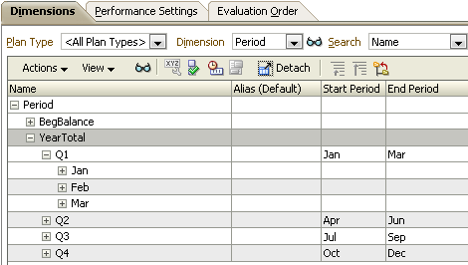
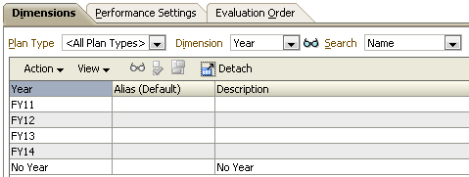
Year & Period Dimensions
Year dimension has years and while we create a Planning application, the number of years required can be defined.
The Period Dimension has more information to give us than the 'Year' dimension. It has summary time periods such as 'Year Total' and Quarters and has members reflecting months that is, from Jan to Dec. The 'Period' dimension again is entirely created by our selection while we create Planning application.

Slide 20
Dense and Sparse
Defining a dimension dense or sparse has a huge impact on the performance of the application. The definition of Dense or Sparse impacts the performance of the cubes and determines the design of the cube.
Dense dimension has high probability of data in the cube whereas the sparse dimension has less probability of data in the cube. The dense and sparse combination determines the data block size and this data block can be imagined as bricks which make up the whole cube.
By default, Account and Period dimension can be dense dimensions and the rest of the dimensions are sparse.

Slide 21
thank you
www.epmvirtual.com

